Slide 1
Epic Data Sources: Mount Sinai Data Warehouse
Intro to Query Tools for Research
Spring 2021

Slide 2
Epic at a glance
In place at MSH since 2011, MSQ since 2013
In clinics since 2008 (now hundreds)
Documentation from providers, nurses
Visit details, timestamped events
Orders, “flowsheets”
Pulls in data from ADT, Bed Mgmt, Labs, Rads, Muse, Echo, Cath, Path, financials & more

Slide 3
Self Service Tools
Built in Epic Tools
Slicer Dicer
Reporting Workbench
Need to Work with Data Team
Caboodle (not self-service)
Other Sources
Mount Sinai Data Warehouse (MSDW)

Slide 4

Data in Epic
Epic Hyperspace
Epic Clarity
Epic Caboodle
hierarchical database
real time
relational database
30000+ SQL tables
not real time
relational database
“Clarity’s greatest hits”
not real time
Chart Review
Epic Reporting Workbench
+ real time
+ less knowledge required
- slow (smaller searches)
Slicer/Dicer
+ in the EPIC interface
- cumbersome to use
Caboodle/Clarity Searches
+ fast
- requires some set-up
- requires SQL competency
Reporting Teams (MS:DW and Epic Reporting)
+ a lot of data and expertise
- $$$
- slower turnaround

Slide 5
MSDW at a glance
Data from MSHS going back to 2003
4+ million patients, 25+ million visits,
Billions of “facts”
Some data is validated and reorganized
Some data is obfuscated (HIV, VIPs)
Includes data from:
ADT
Financial systems
Labs
Path
And other stand alone systems

Slide 6
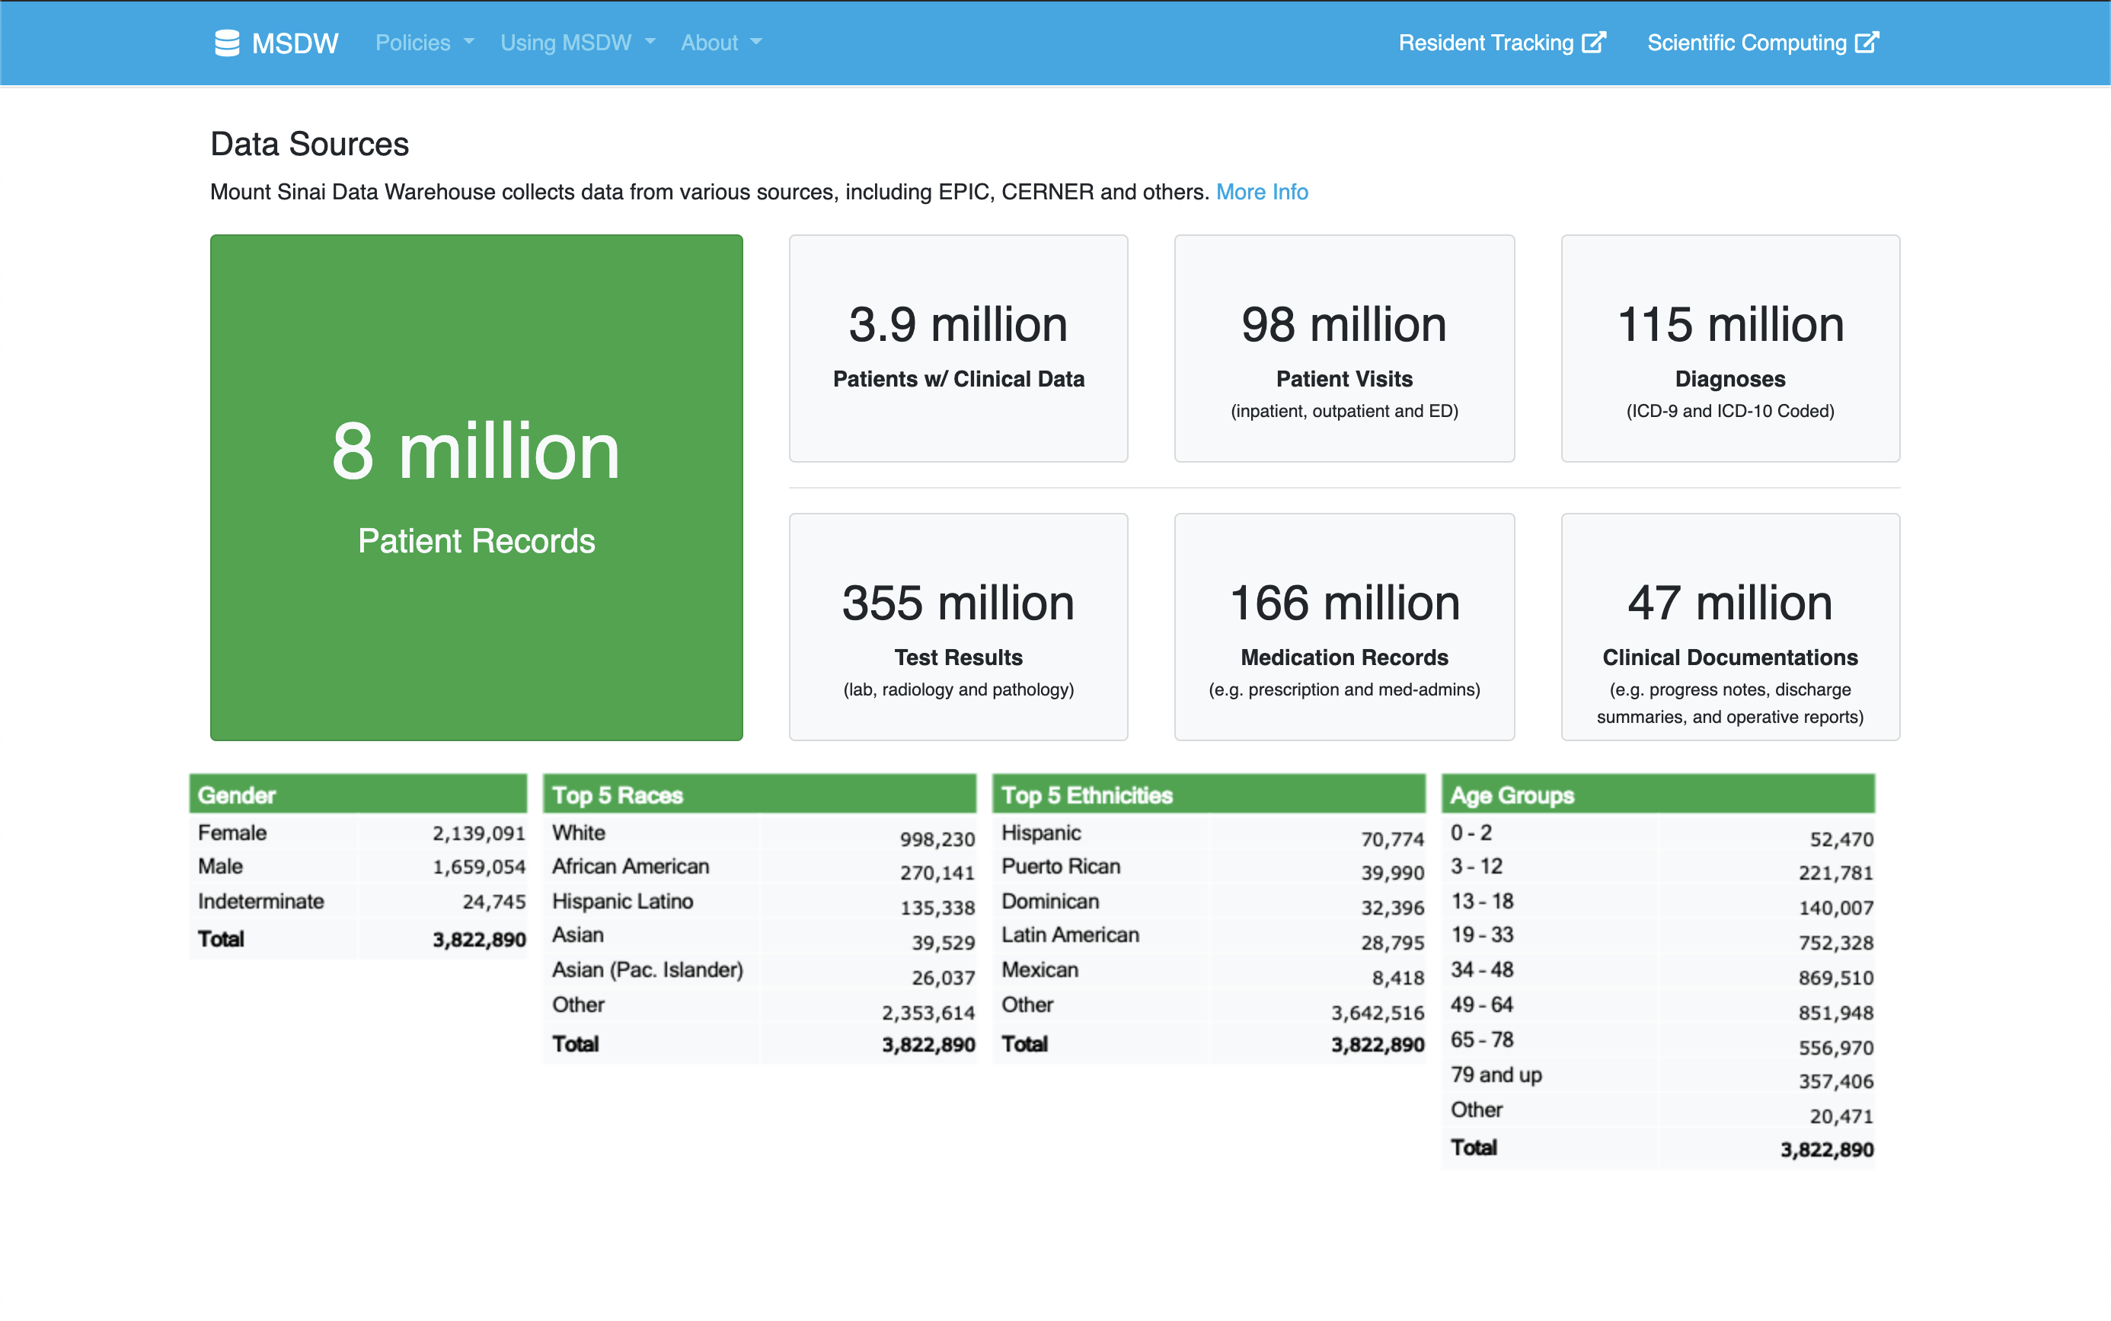

Slide 7
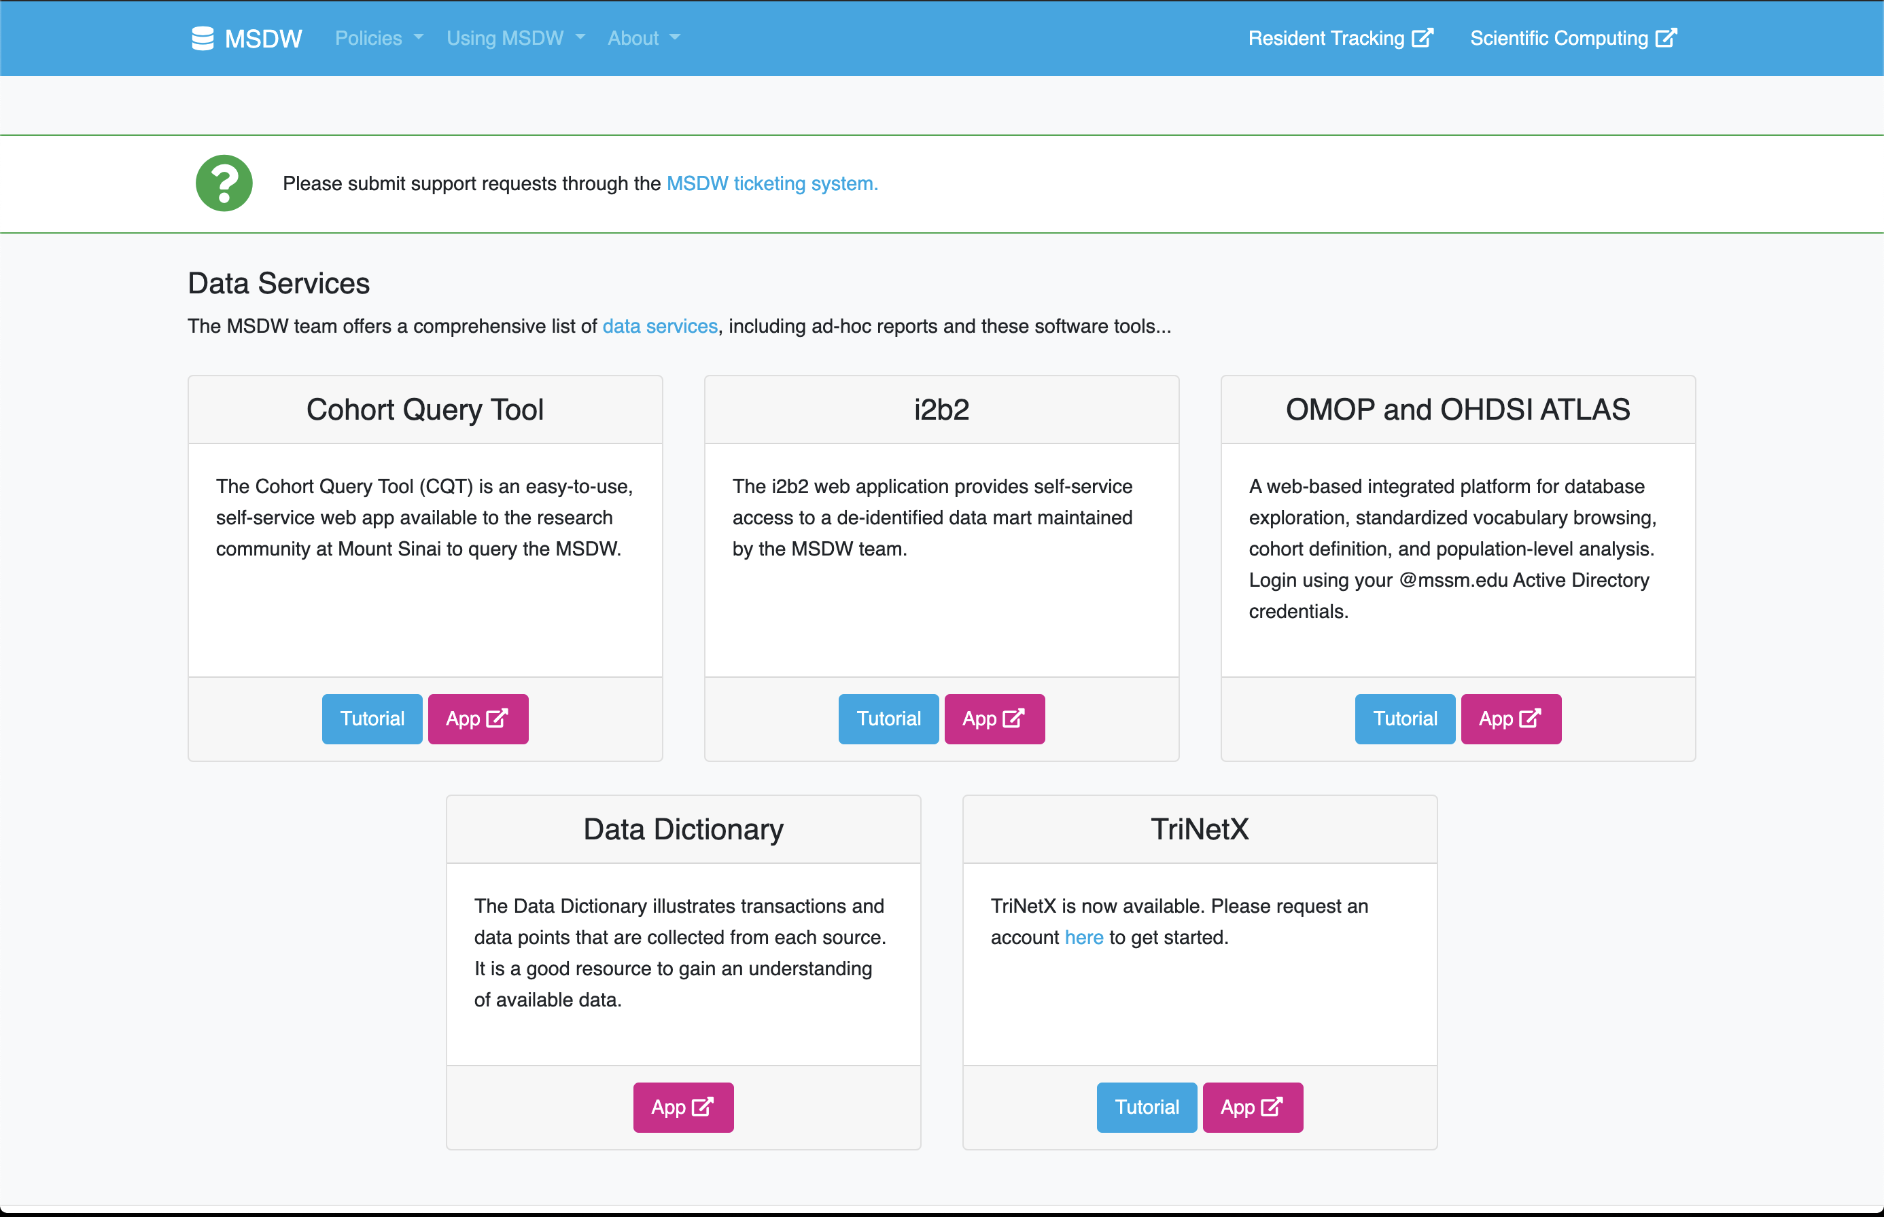
Tools to Choose From

Slide 9
MSDW Cohort Query Tool
Web-based way to browse
Aggregated, de-identified data
Data from Epic, Cerner, Eagle, TDS and other systems in the MSDW
Can Union / Intersection sets
If IRB-approved, can create sets of interest with identifiers

Slide 10
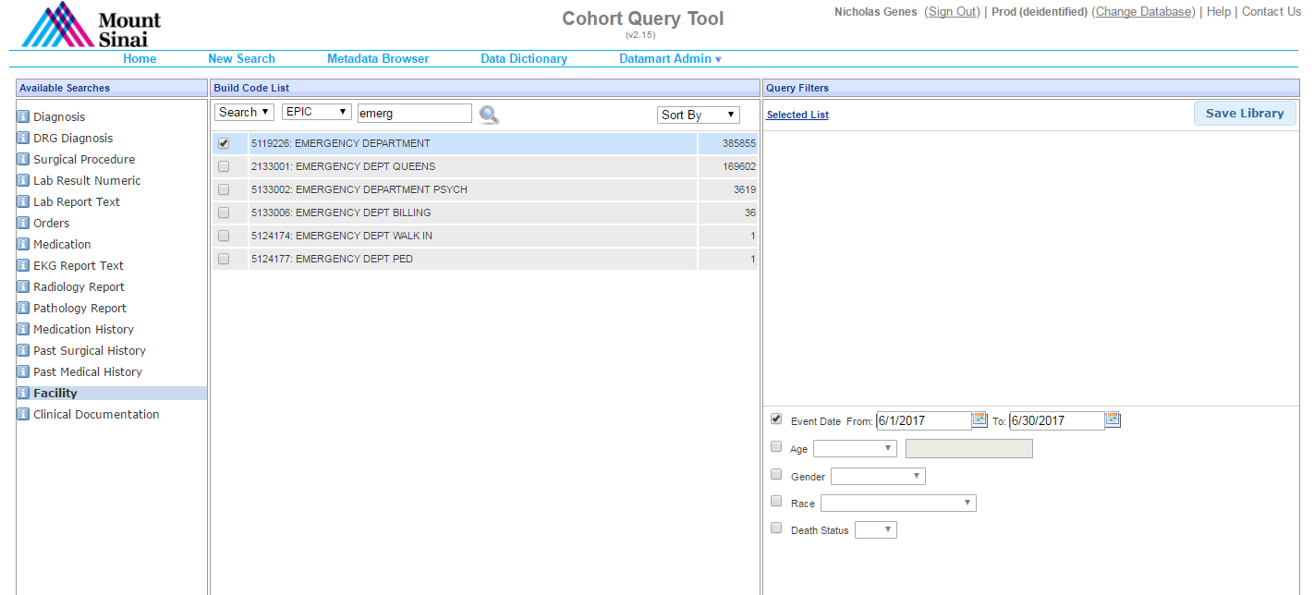
Search parameters and selection tools

Slide 11
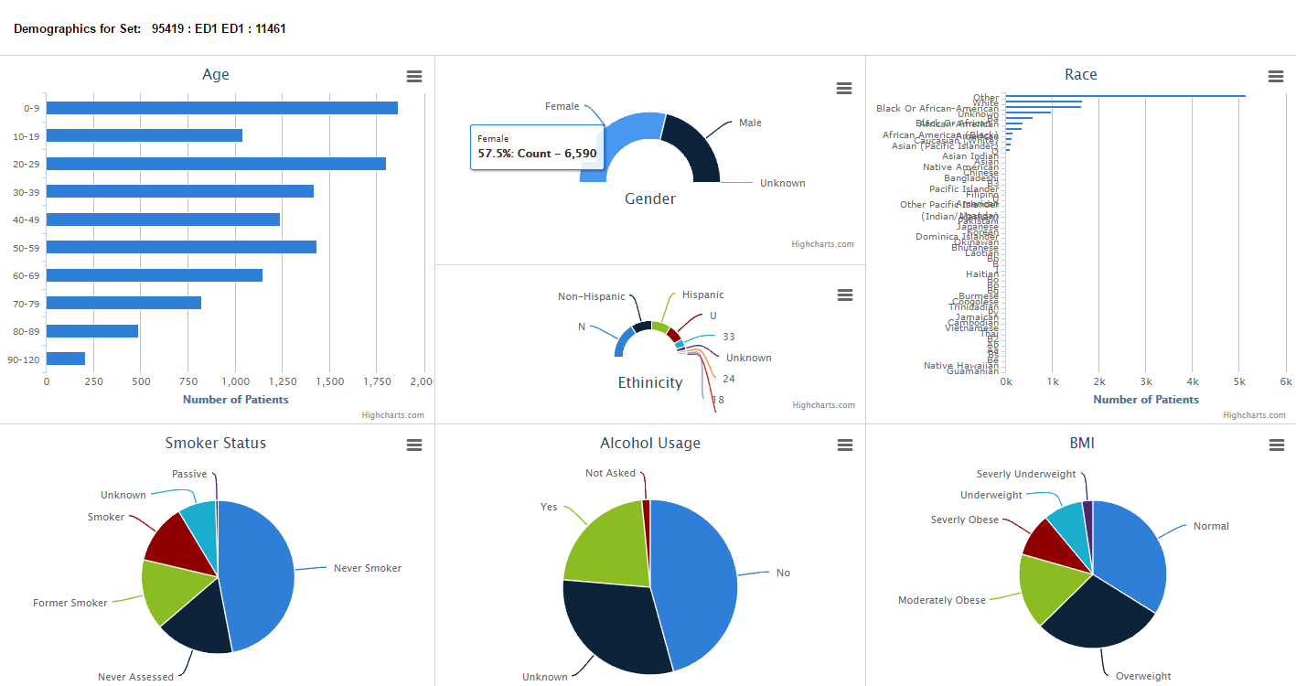
Example of Results from Query

Slide 12
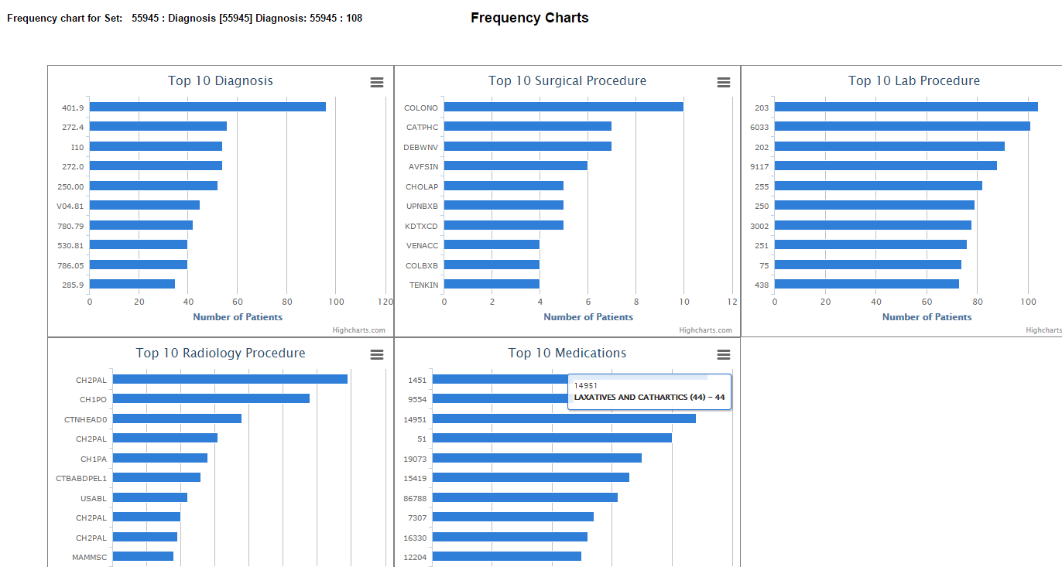
Example of Results from Query

Slide 13
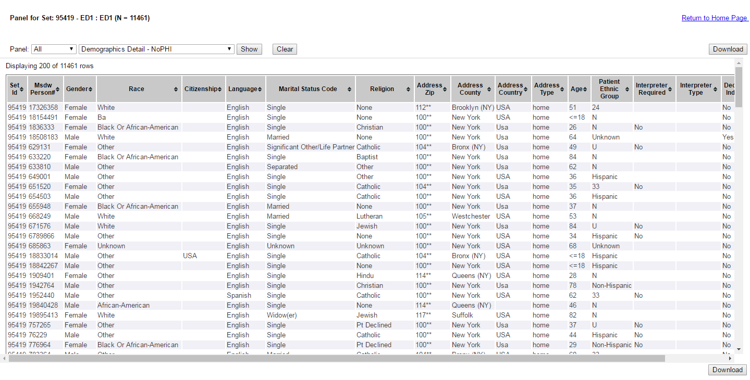
Example of Deidentified Patient Level Results from Query

Slide 14
MSDW Cohort Query Tool
Pros:
Self-service (No external costs)
Easy to use
Provides estimates of a wide range of patient and visit level factors
Cons:
Only de-identified data available (need to work with analyst to pull data once project is IRB approved)
Data is aggregated or obfuscated

Slide 15
Additional MSDW Tools
MSDW has trainings on their website for each tool.

Slide 16
Comparison of MSDW Tools
 | Custom Queries | Cohort Query Tool | OMOP Query Tool | TriNetX
Data type | All MSDW | Facilities, Diagnoses & DRGs, Procedures, Meds, Labs, Orders, EKG reports, Rads & Path reports, Clinical Documentation, Demographics | Facilities, Diagnoses & DRGs, Procedures, Meds, Labs, Orders, EKG reports, Rads & Path reports, Demographics | Providers, Diagnoses, Procedures, Meds, Labs, Demographics
Cost | $180/hr | Free* | Free* | Free*
PHI | Yes | Yes (if IRB Approved) | No* | No*
Turnaround | Weeks | Seconds to Minutes | Minutes | Minutes
Capabilities/Limitations | Custom search; Requires working with MSDW team | Contains all MSDW patients; Can search BioME patients; Can search Image Research Warehouse patients | Common data model and queries; Numerous query analysis tools available in github | Intuitive user interface; Connected to >300 million external patients (fee)

Slide 17
Important to Remember
How are you using the data:
Research requires an IRB!!!
Speak with research faculty about requirements
IRB determines if study is exempt
Start with least amount of PHI necessary
You are responsible for your data
Keep data secure (computer, email, drives)
Reported data must be aggregated for research purposes

